Slide 2
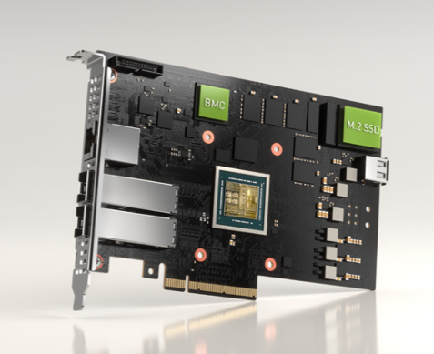
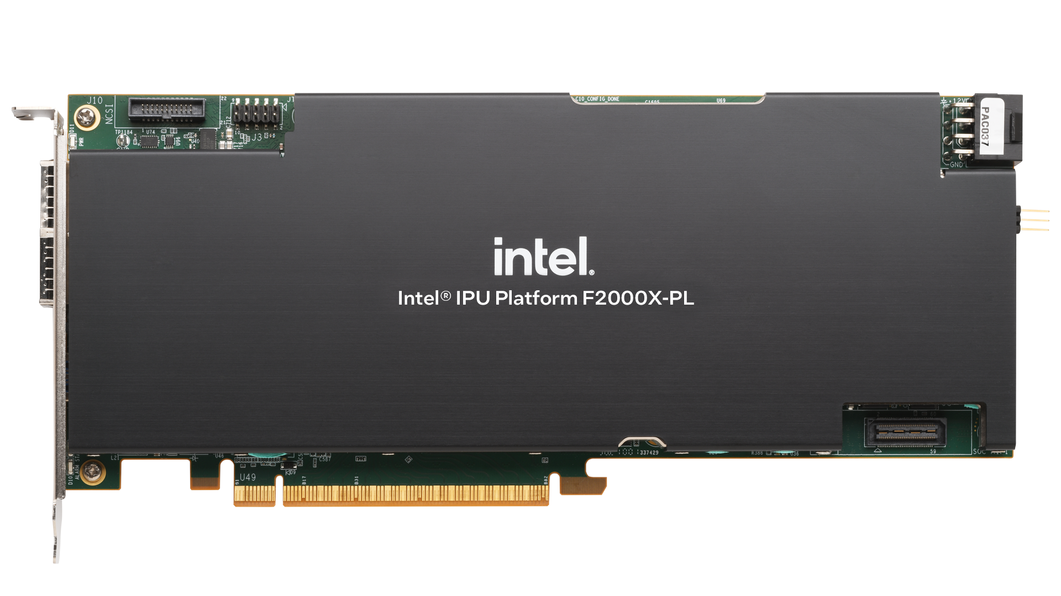
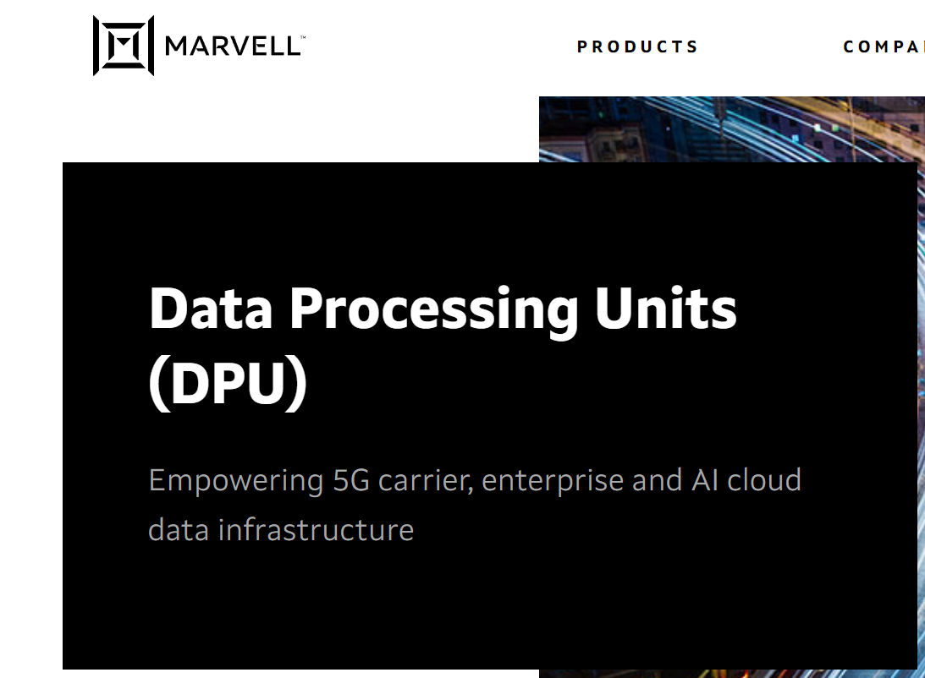
OPI's vendor agnostic API-driven configuration
Nvidia BlueField2/3
Intel Dayton Peak
Marvell CN106

Slide 3
Intel IPU IPsec Demo
Intel Dayton Peak
Demo Highlights:
Intel IPU Dayton Peak terminating IPsec tunnel
IPsec configuration using OPI’s vendor-agnostic API
Validating end to end IPsec using Keysight CyPerf

Slide 4
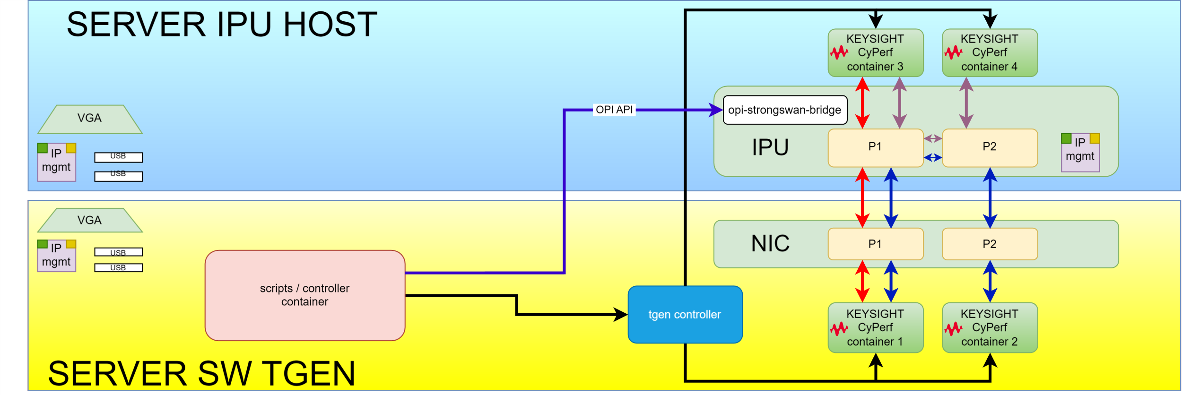
Testbed Topology
https://github.com/opiproject/opi-poc/tree/main/lab

Slide 5
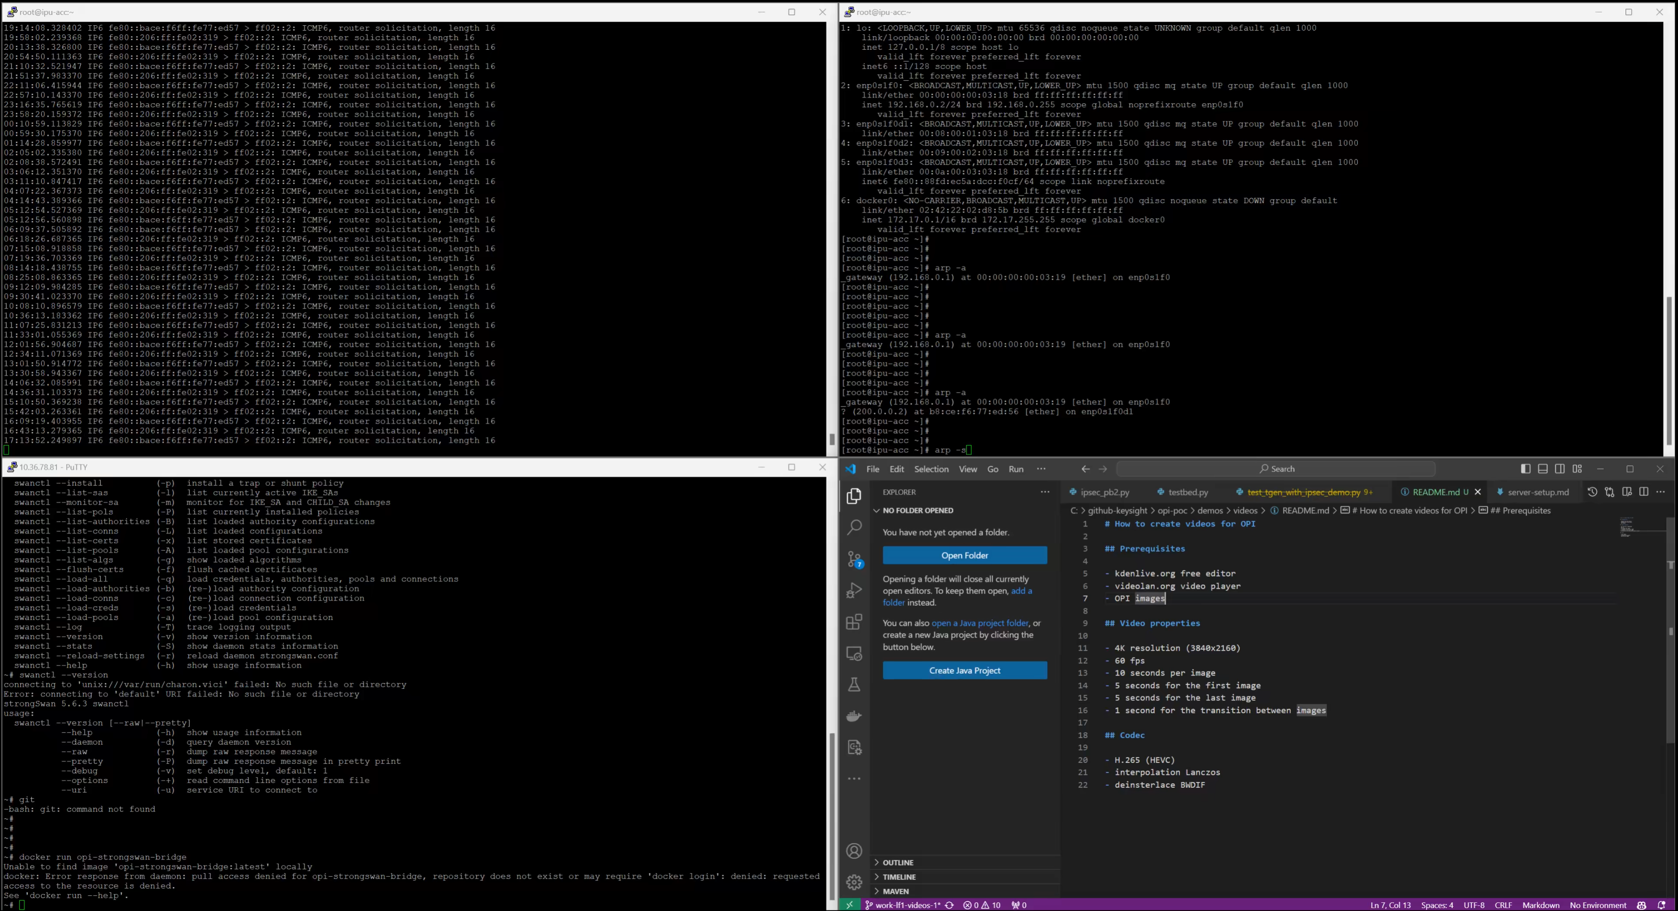
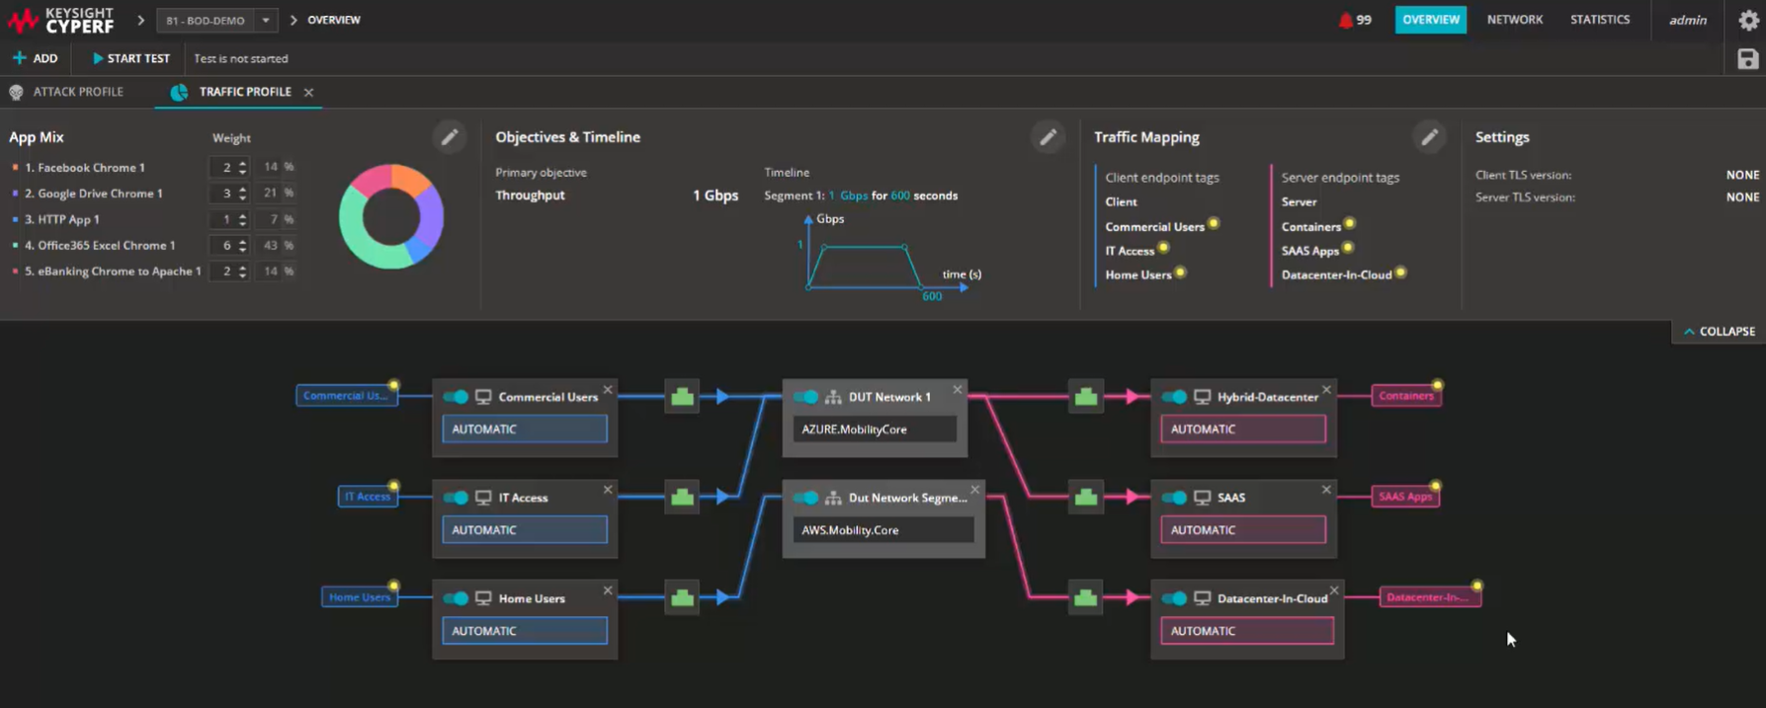


CyPerf
Keysight CyPerf traffic generator
Real time applications measurements

